Slide 1
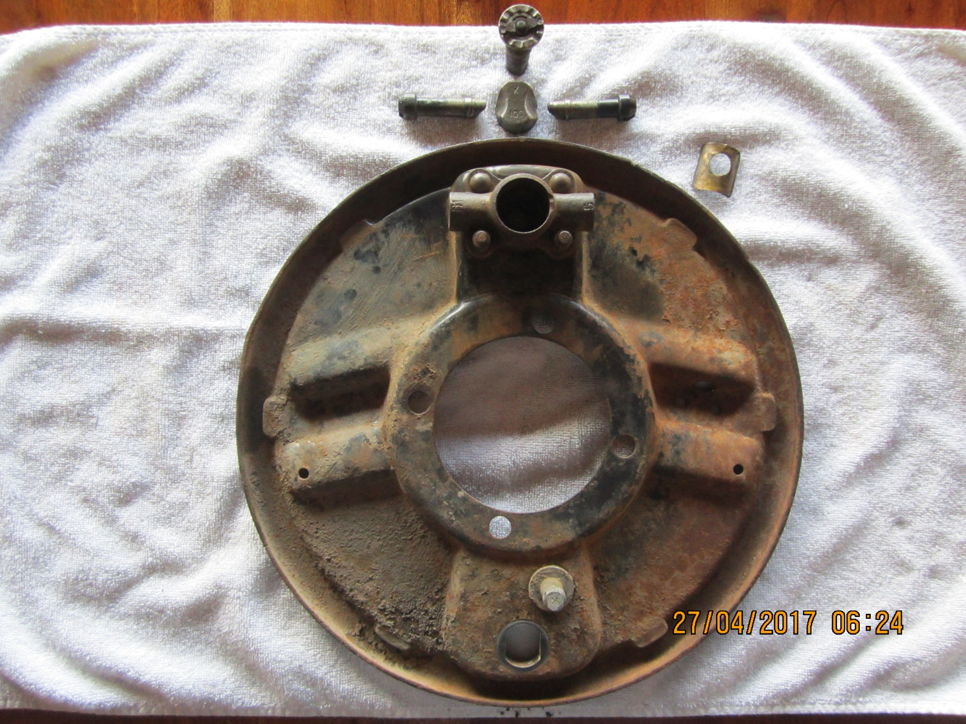
This paper thin copper bushing of sorts was inside where the expander is located.
Exploded view of 37 brake parts

Slide 2
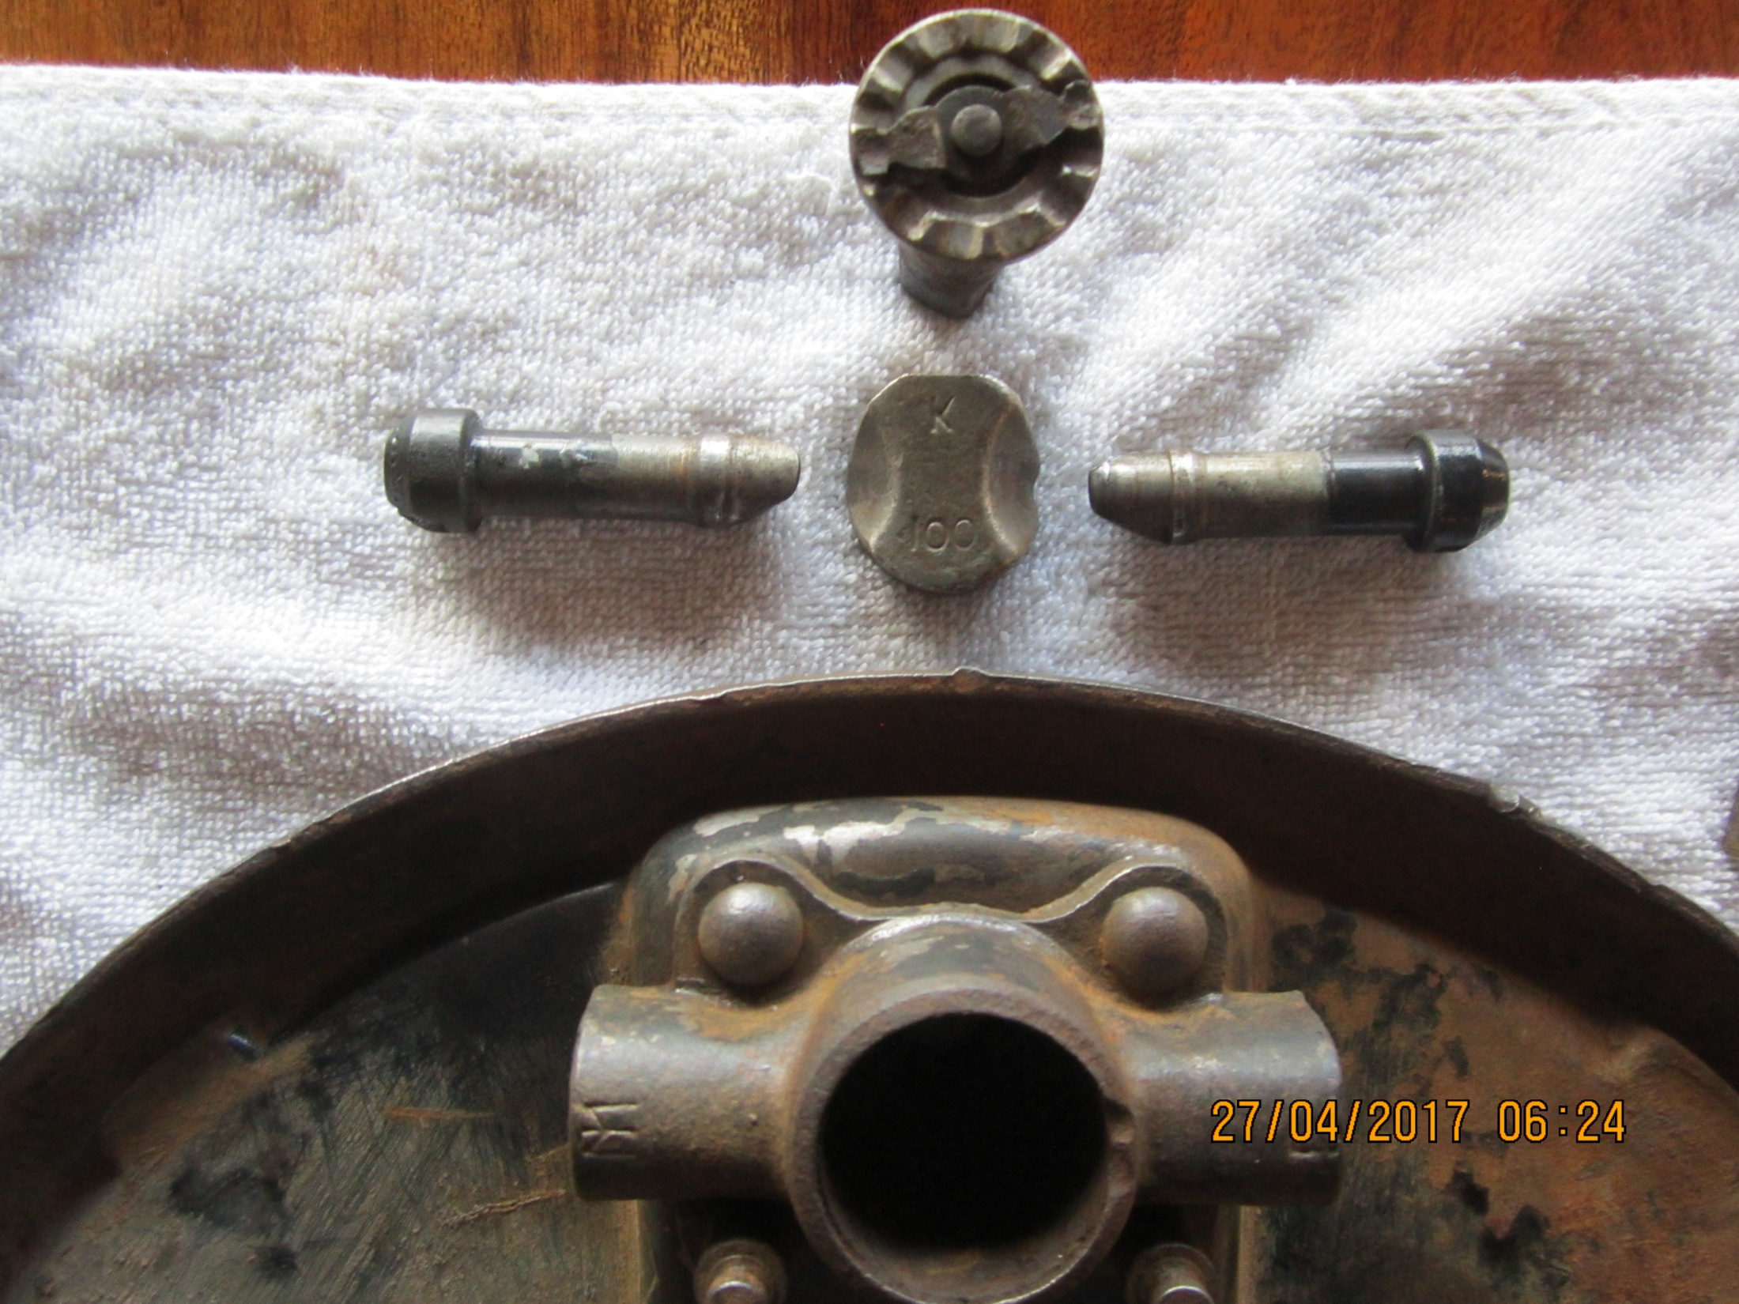
This is an interesting piece. It pushes on the expander during adjustment. It then starts “slipping” when things get max’d out.

Slide 3
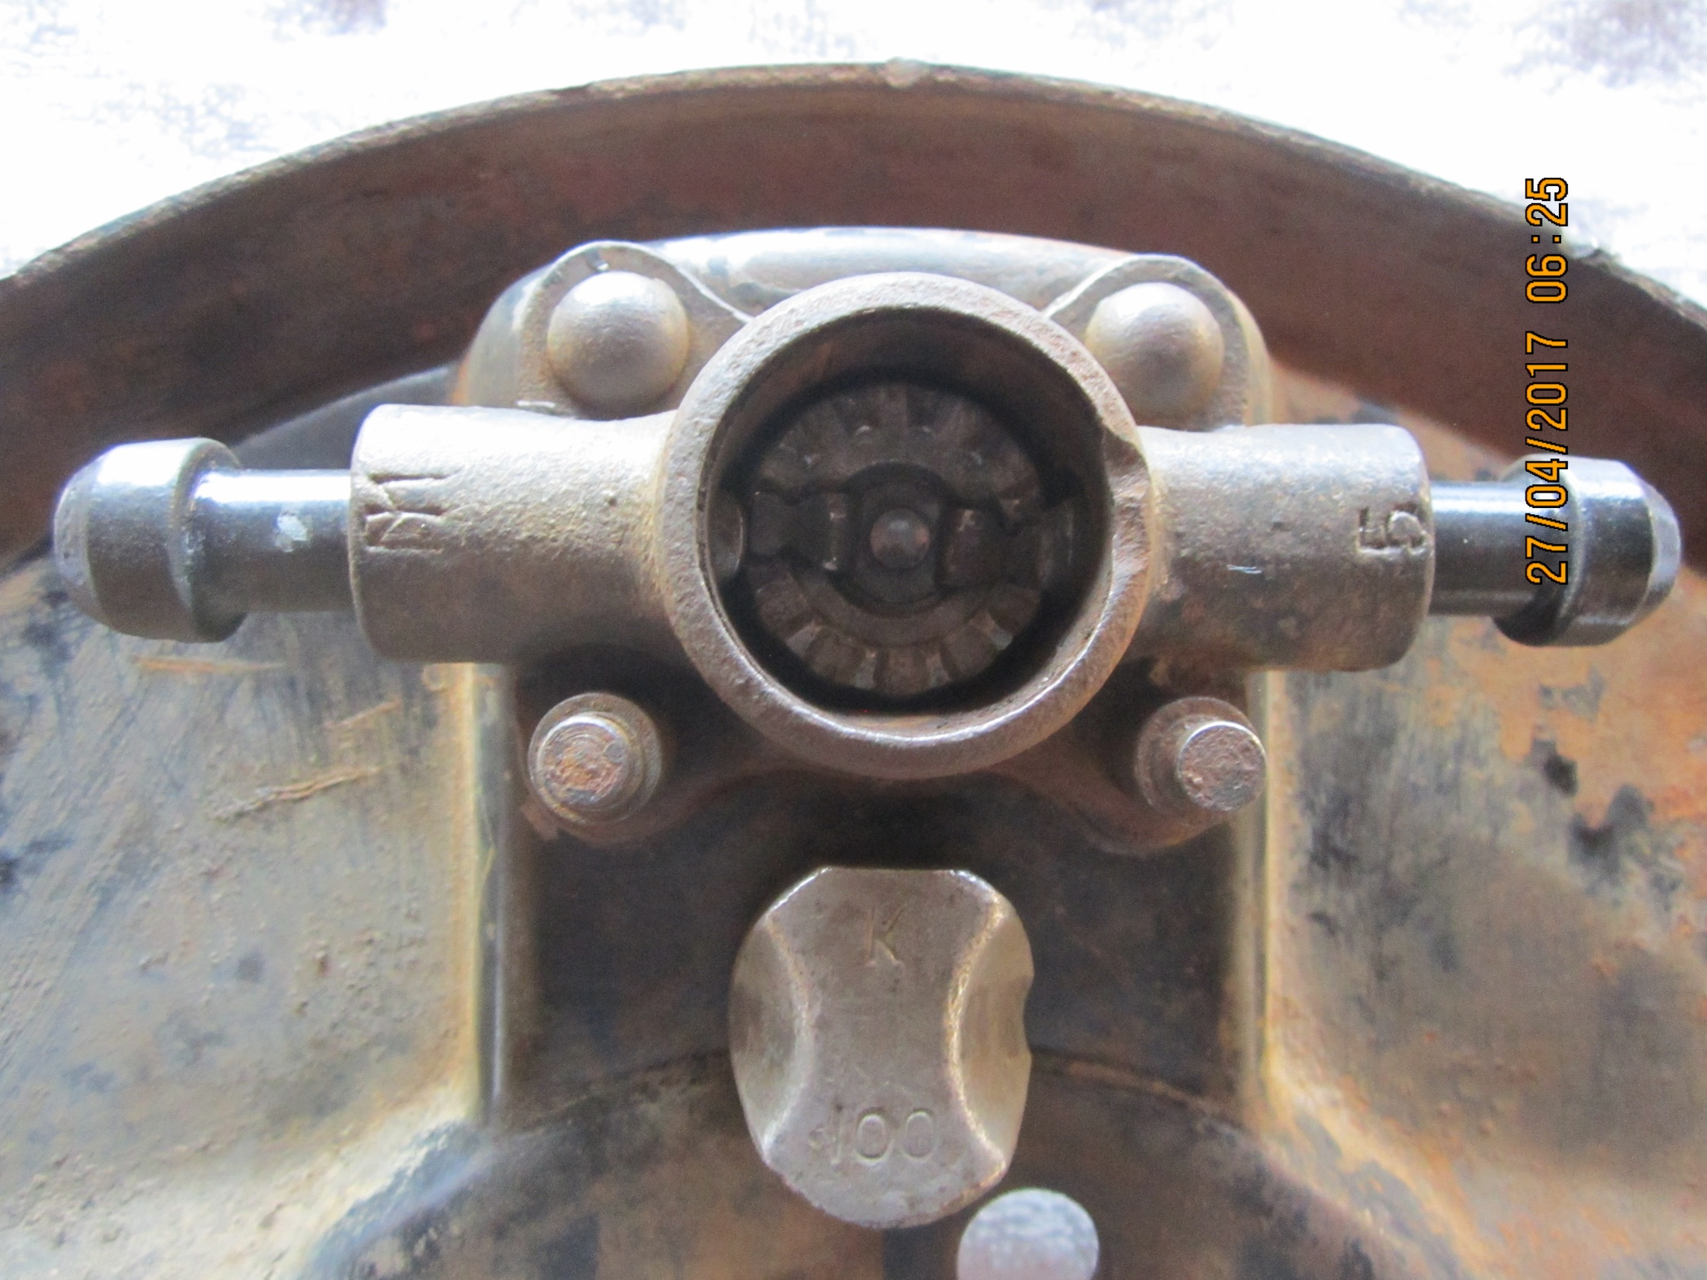
Close-up of adjuster
Just sitting here, it goes above into the adjuster mechanism.

Slide 4
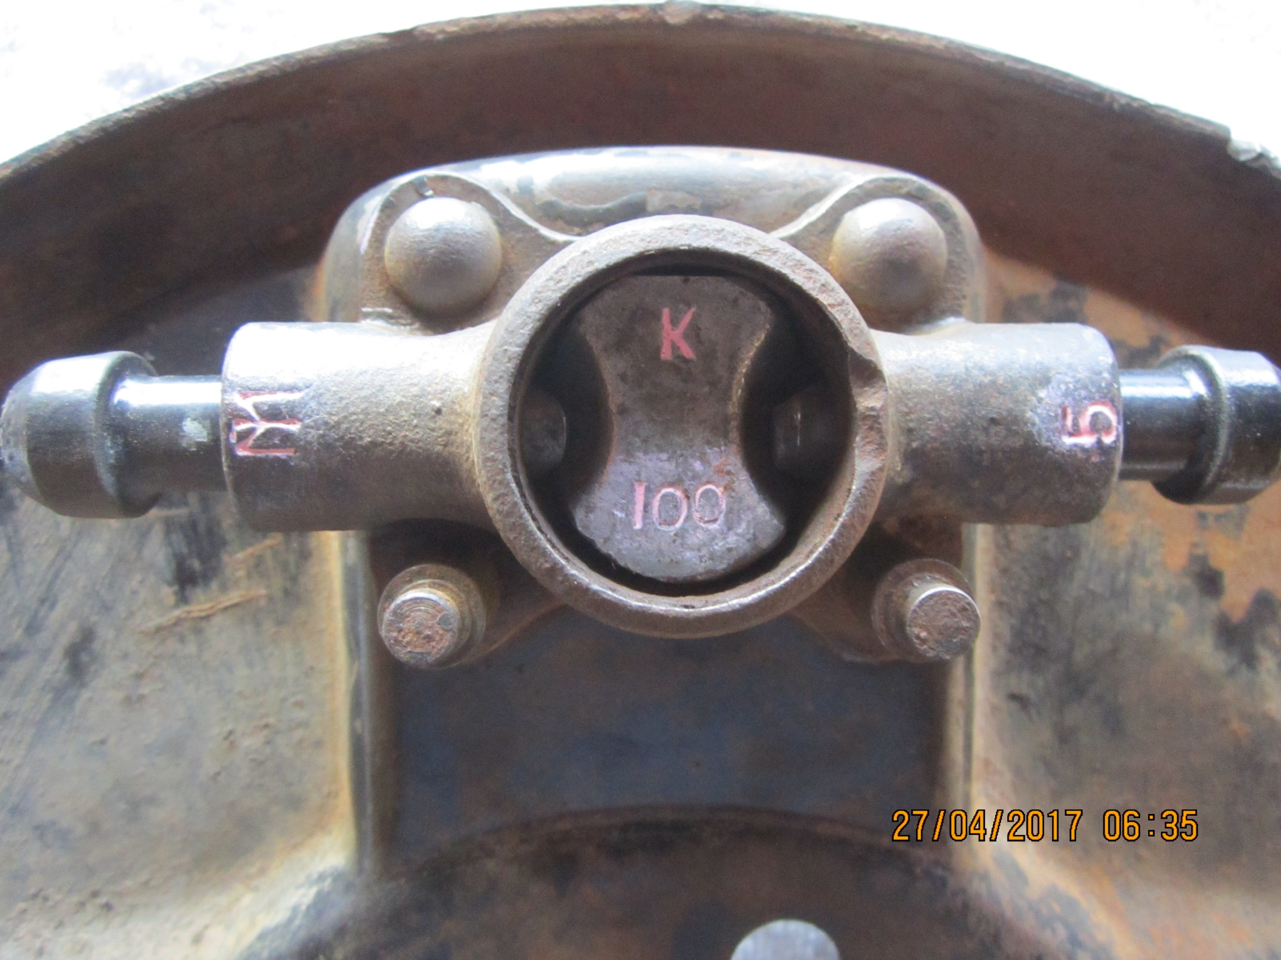
Everything installed except the copper piece and cover cap.
Can anyone expand on what the letters & numbers mean?

